Slide 1
Standard User – Contracts Editor Features: Internal and External Parties
August, 2013

Slide 2

Learning Objectives
Upon completion of this course you will be able to:
Complete the Parties tab information
Define and Modify Internal Party information
Define and Modify External Party information
Change the Roles for External Parties

Slide 3
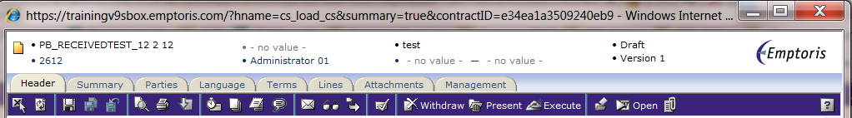
Contract Editor Tabs
The Contract Editor has several tabs and icons that you use to work on your contract. Tabs include:
Header tab: contains general information about your contract
Summary tab: displays a Management Summary; a single place to view key elements of the contract. This replaces cover sheets used for paper contracts and gives approvers a very clear summary of what the contract is about. It includes:
  Text area(s) to add additional information/summary about contract
  Terms
  Modified/replaced clauses – with or without the clause text
  Specific clauses
  Relationships
  Custom properties
  Activity – who reviewed this or who approved it
Parties: identifies the Internal Contact(s) and External Party/Parties for the contract
Language tab: contains the contract language
Terms tab: contains the variable information and values defined by the template
Lines: applied to a Purchase or Sales Agreement and contains product/price information
Attachment tab: contains documents associated with your contract
Management tab: helps you manage the contract lifecycle

Slide 4
Parties Tab

Slide 5
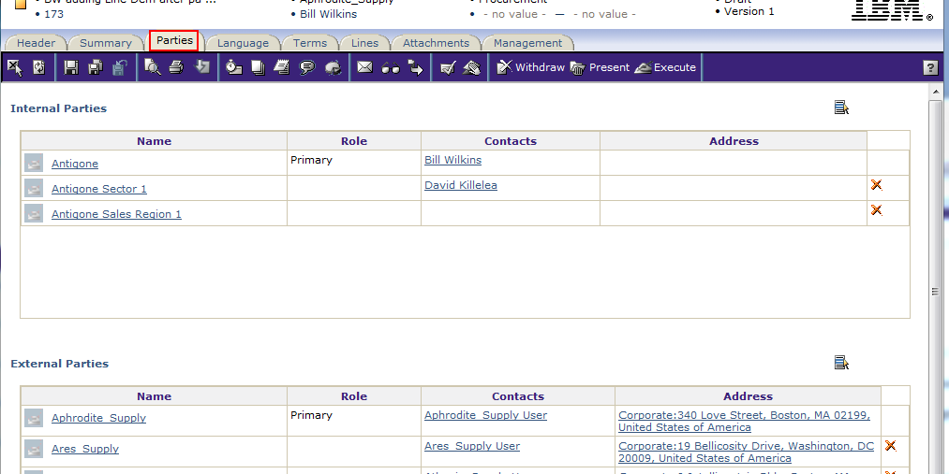
Parties Tab
The Parties tab is where you can view or modify the Internal and External Parties.
All Parties/Organizations must have been created in Strategic Supply Management (SSM).
The Primary Internal party is the legal owner of the contract.
  This Internal Contact will receive all notifications and emails about this contract.
  The Internal Party organization name defaults to the ‘legal’ organization of Primary Internal Contact.
The External Party is the organization or individual with which the Company is negotiating.
Multiple Internal and External Parties can be identified.

Slide 6
Defining the Internal Party
The default Internal organization is the one to which the contract creator is assigned. He/she is listed as the Primary contact for this contract for this organization.
Multiple Internal Party organizations may be identified; however, there is only one Primary Internal Contact name that cannot be deleted.
To add Internal Party organizations, click the Select Organization icon at the far right of the field.
The Select Organization dialog box is displayed.

Slide 7
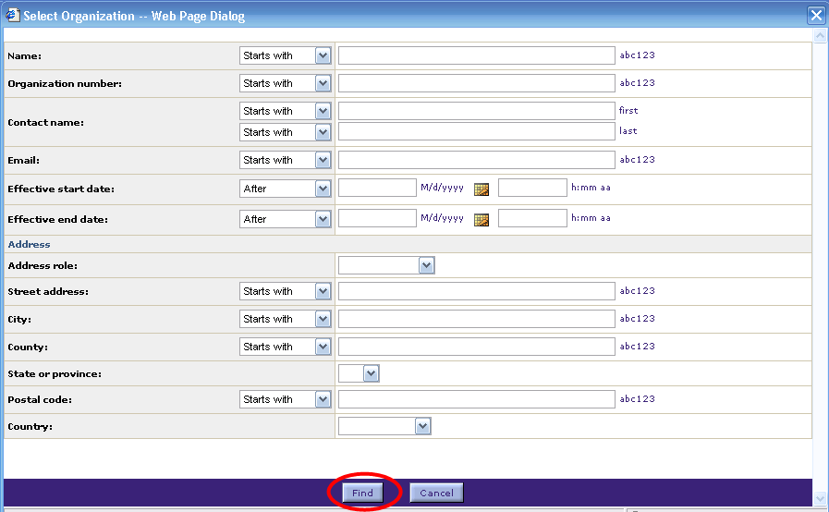
Searching for Internal Party
To modify the Internal Contact name, enter the search criteria or leave the fields blank to display a list of all available organizations.
Click Find. The list of organizations is displayed.

Slide 8
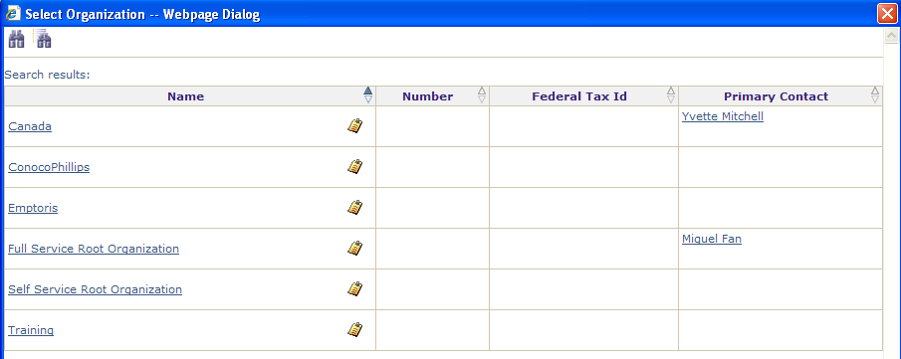
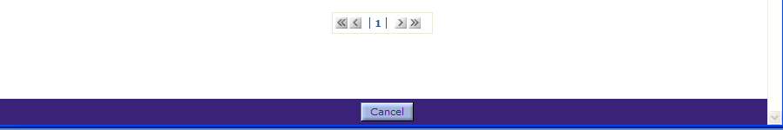
Choosing Internal Party
Use the page number menu or chevron buttons to navigate to the page containing the name of the appropriate organization.
Click the organization's Name hyperlink to select it.
  Note: Click the small clipboard icon to display the properties (name, location, etc.) of the organization.

Slide 9
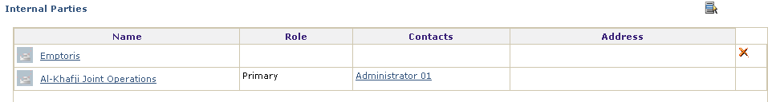
Choosing the Internal Party
The Organization is added to the Internal Parties list.
  You can add as many organizations as needed.
To delete an organization, click the icon at the far right of the table.
To edit the information about an Organization (such as the contact name), click its Organization Name hyperlink. (This changes the organization information for this particular contract, not for the master version in SSM.)

Slide 10
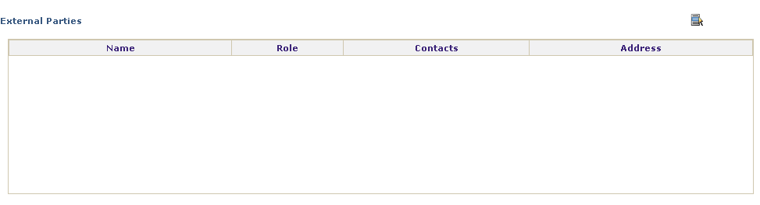
Defining the External Party
Multiple External Party organizations or individuals may be identified.
However, there is only one Primary External party, which cannot be deleted (at least until another Primary is designated).
To select the External Parties, click the Select Organization icon at the far right of the field.
The Select Organization dialog box is displayed.

Slide 11
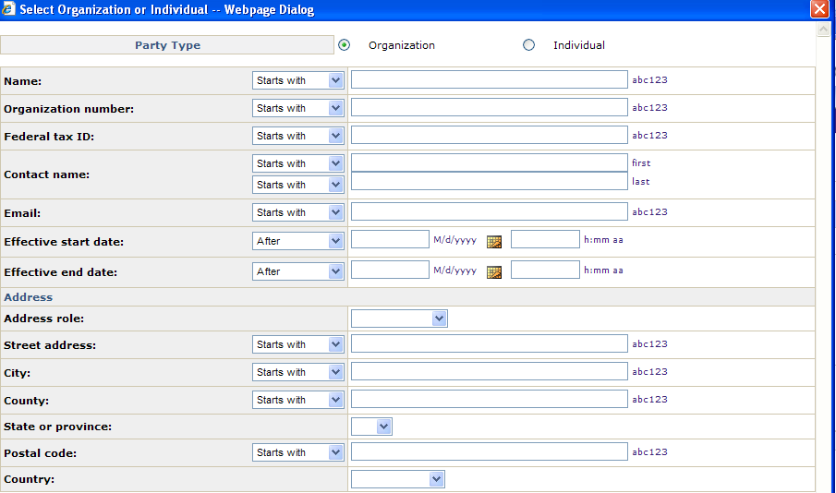
Select Organization Dialog Box
Click the radio button to identify the Party Type (Organization or Individual).
Enter the search criteria or leave all fields blank to display all of the external party organizations.
Click Find. If the External party is not in SSM, users with the appropriate level of permission will need to add it to SSM for use in ECM.

Slide 12
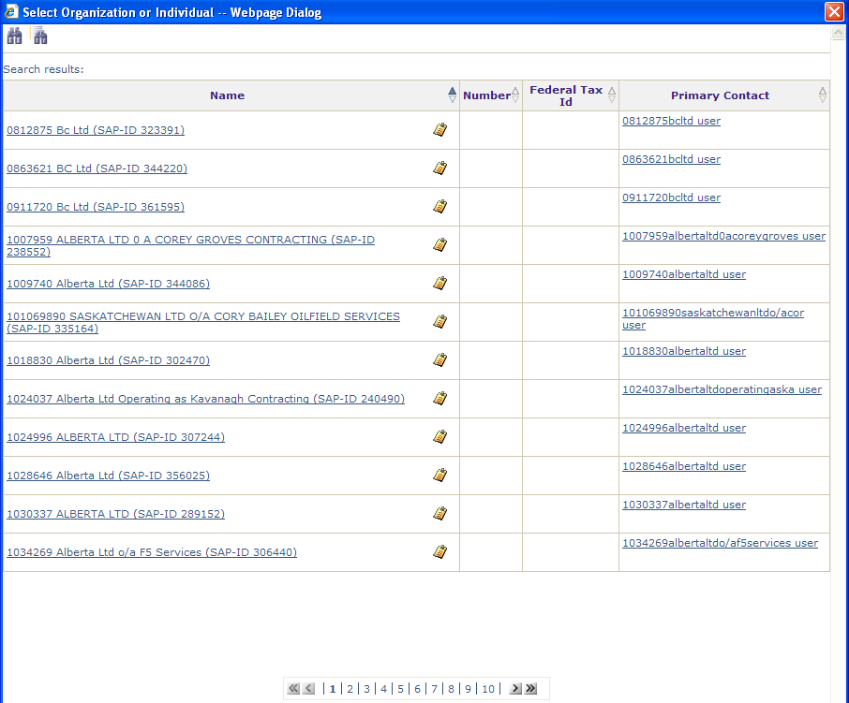
Identify the Organization
Use the page number menu or chevron buttons at the bottom of the screen to navigate to the page containing the name of the appropriate organization.
Click the organization's Name hyperlink to select it.
Note: Click the small clipboard icon to display the properties (name, location, etc.) of the organization.

Slide 13
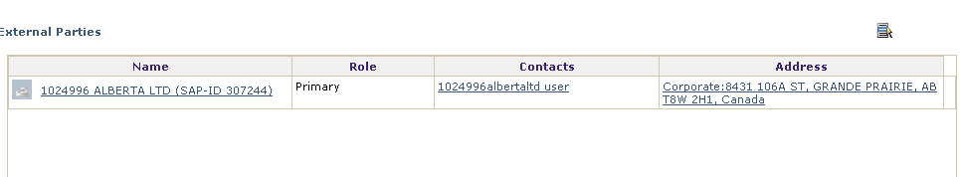
Identify the Organization, cont.
The external organization is displayed on the Parties tab as the Primary Organization.
The Address and External Contact information are populated from the record within the system.
  There are several addresses available for an Organization.
  The address displayed here defaults to the Corporate address; this default setting can only be changed by the Global Administrator.
Although not displayed, other information is available about this organization such as the phone number or email address for the External Contact. This person will receive email notifications in regard to this contract.
  To modify or edit the information about this organization, click its Name hyperlink.

Slide 14
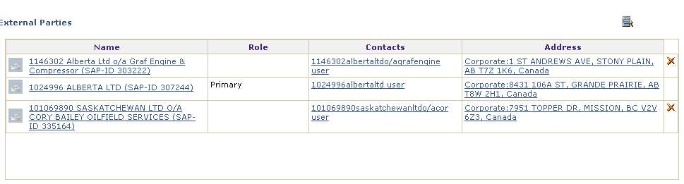
Identify the Organization, cont.
The external organization is displayed on the Parties tab as the Primary Organization.
Add other organizations as needed.
You may delete these additional organizations, but not the Primary organization.
Click the icon to delete an External Organization.

Slide 15
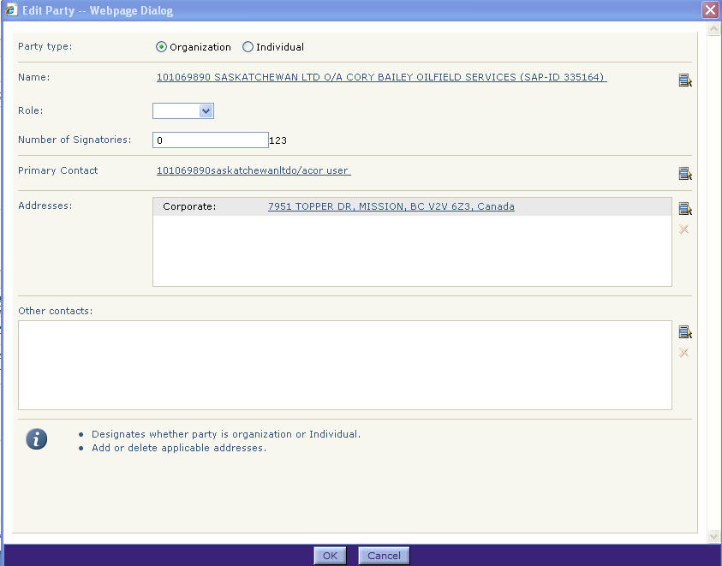
Change a Primary Contact
Only one Internal and one External party can have the Role of Primary contact for a contract.
To change a party's Role and also other information about it, click on the Party's Name hyperlink.
The Edit Party dialog box is displayed.
To give this Party the Primary role, select Primary from the Role drop down menu. The Primary role will be assigned, and taken away from the previous Primary contact.
Click OK to apply the change.

Slide 16
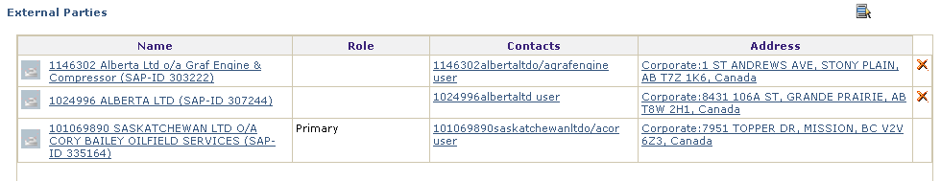
Change a Primary Contact, cont.
The Primary Contact Role has been reassigned to the other organization.
Click Save to apply the change.

Slide 17

Questions?

